Slide 1
Microservices and DevOps
Scalable Microservices
Docker Health Check
Henrik Bærbak Christensen

Slide 2
Nygard
Health Check:
  A health check is a webpage/API call that reveals the application’s internal view of its own health. [Nygard, p 169]
    IP address, version of runtime, service version, status (accepting work), state (connection pools, caches, circuit breakers, …)
That is,
  Instead of (in addition to) the centralized monitoring system reporting health of a service, the service itself provides it
    Not really of any use, in case the service has failed…
Notes:
Nygard 2nd ed p 169

Slide 3
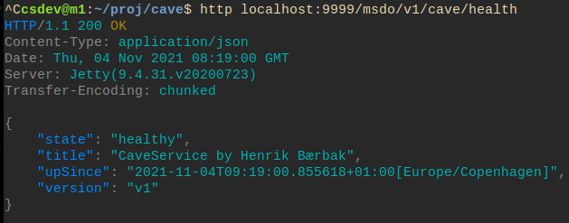
Ex: /health of CaveService
Example: Added a health path to my cave service
  Pretty easy, just another route with relatively hard-coded data…

Slide 4

Docker Support
Your Dockerfile supports container healthchecks
  Ex: Check every 5 min that main page is responding in < 3secs
  This is a rudimentary check, better to provide a /health path with e.g. JSON payload that describe health – like my previous
  example
Of course, your application must then provide that particular /health path !

Slide 5
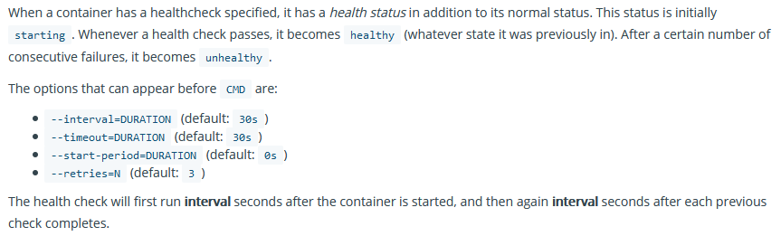
Docker Support
If it does not appear ‘healthy’ after the N retries, the container stops

Slide 6
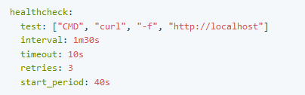
Use in Swarm
The swarm will restart a container (given section ‘restart-policy’) if it is not healthy
Compose-file may overrule the healthcheck (or add it)
Notes:
Source: https://howchoo.com/g/zwjhogrkywe/how-to-add-a-health-check-to-your-docker-container

Slide 7
Example

Slide 8
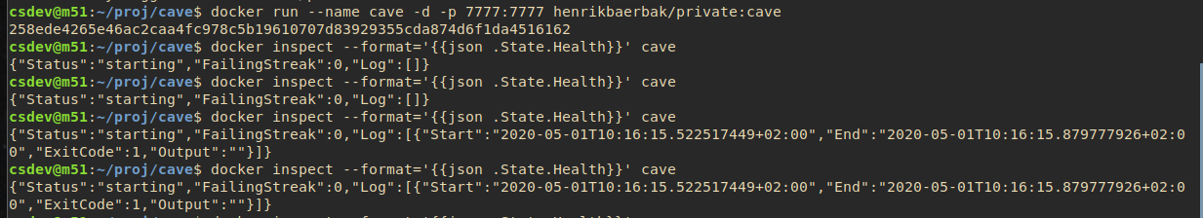
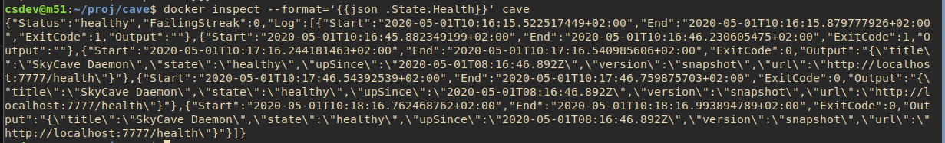
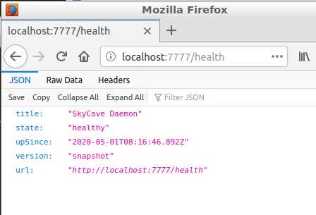
/health on Daemon
Healthcheck in Dockerfile

Slide 9
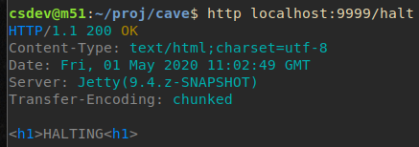
Health in Compose
Added healthcheck in compose on my CaveService
Added path ‘/halt’ that stops the web server!

Slide 10

Health in Compose
Morale: Simple ‘control plane’ behavior is possible in swarm…
Notes:
Having a restart policy for the cave service, allows detecting an unhealthy service and then restart it.

Slide 11
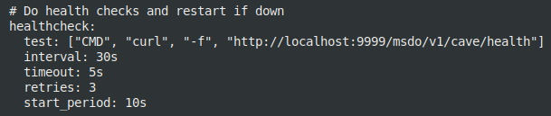
A failure experiment
I tried in my ‘strangled’ cave consisting of
  Daemon + CaveService
To view the startup process..
It seems that…
  (though I find the docs pretty ambigous)
  The container is not ‘ready for action’ until the first healthcheck has passed…
  Which means my Daemon did not work until the interval period had expired…

Slide 12
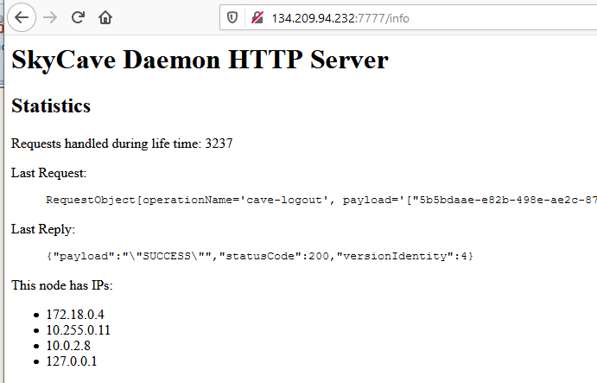
Summary
Healthchecks can serve two purposes in a container context
  As a web page we can inspect to review ‘interesting stuff’
    Ala…
  As a container mechanism to
  control restarts and simple
  monitoring
  Caveat: ‘curl’ is itself a pretty big
  package to require to be installed in the container…

